Slide 1
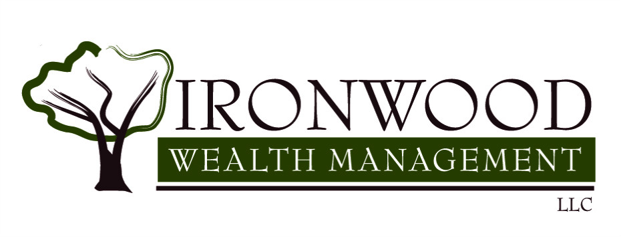
The SECURE Act: Setting Every Community Up for Retirement Enhancement Presented by Ironwood Wealth Management In Conjunction with Soto Law Firm Presenter: Alex Marek Panelists: Cean Rogers, Jeff Tolonen, Chris Soto January 30th, 2020
Ironwood Wealth Management
4650 E Cotton Center Boulevard
Suite 130
Phoenix, AZ 85040
www.ironwoodwm.com
(480) 776-5960
info@ironwoodwm.com

Slide 2
Disclosures
Please remember that past performance may not be indicative of future results. Different types of investments involve varying degrees of risk, and there can be no assurance that the future performance of any specific investment, investment strategy, or product (including the investments and/or investment strategies recommended or undertaken by Ironwood Wealth Management, LLC), or any non-investment related content, made reference to directly or indirectly in this presentation will be profitable, equal any corresponding indicated historical performance level(s), be suitable for your portfolio or individual situation, or prove successful.
Due to various factors, including changing market conditions and/or applicable laws, the content may no longer be reflective of current opinions or positions. Moreover, you should not assume that any discussion or information contained in this presentation serves as the receipt of, or as a substitute for, personalized investment advice from Ironwood Wealth Management, LLC. To the extent that a reader has any questions regarding the applicability of any specific issue discussed above to his/her individual situation, he/she is encouraged to consult with the professional advisor of his/her choosing. Ironwood Wealth Management, LLC is neither a law firm nor a certified public accounting firm and no portion of the presentation content should be construed as legal or accounting advice.
If you are an Ironwood Wealth Management, LLC client, please remember to contact Ironwood Wealth Management, LLC, in writing, if there are any changes in your personal/financial situation or investment objectives for the purpose of reviewing/evaluating/revising our previous recommendations and/or services. A copy of the Ironwood Wealth Management, LLC’s current written disclosure statement discussing our advisory services and fees is available upon request.
This material is not intended to replace the advice of a qualified tax adviser. Individuals should contact their own tax professionals to help answer questions about specific situations or need prior to taking any action based on this information. We believe the information provided is reliable, but do not guarantee its accuracy, timeliness, or completeness.
Notes:
Read disclosures

Slide 3
Overview
The SECURE ACT
Was part of a larger government spending package signed into law on 12/20/2019.
Includes reforms to make saving for retirement easier & more accessible.
Has substantive repercussions to various financial, tax & estate planning strategies.

Slide 4
The SECURE Act – 10 Key Changes
1) Allows parents to withdraw up to $10,000 from 529 plans to repay student loans
2) Increases the required minimum distribution (RMD) age to 72 (up from age 70.5)
3) Eliminates the "stretch" provisions for many non spousal beneficiaries of retirement plans
4) Permits parents to withdraw up to $5,000 ($10,000 if married) from retirement accounts, penalty-free, within a year of birth or adoption (for qualified expenses)
5) Repeals the maximum age for traditional IRA contributions (formerly age 70.5)

Slide 5
The SECURE Act – 10 Key Changes
6) Increases the tax credits available to small businesses for starting a retirement plan
7) Facilitates small businesses opening multiple employer plans (MEPs), where unrelated employers can join-together to offer to offer retirement plans
8) Allows long-term, part-time workers to participate in employer sponsored 401(k) plans
9) Offers more "lifetime income" options in workplace retirement plans, and greater portability of "lifetime income" investments
10) Raises the cap for automatic enrollment contributions in workplace retirement plans from 10% to 15%

Slide 6
The Secure Act – 529 Plans
"Qualified Education Loan Repayment" distributions can be used to pay principal and/or interest of a qualified education loan) but are limited to a lifetime amount of $10,000 per-student
There is no Federal tax deduction for contributions to a 529 plans
State laws vary widely in terms of tax treatment of 529 contributions: many states offer a tax deduction and a few states (Indiana, Minnesota, Utah and Vermont) offer tax credits
With a 529 plan, your college savings grows tax-deferred and you pay no tax on withdrawals for qualified higher education expenses. As of 2018, withdrawals are no longer limited to post-secondary education expenses and can also include K-12 private school education costs ($10k per year limit on K-12 expenses)
Allows for certain “apprenticeship” programs.
Planning Tip: In some states, you might be able to get a discount on your student loans by funneling the loan payment through a 529 plan and claiming state tax deduction or tax credit.

Slide 7
The SECURE ACT - RMDs
RMDs now begin at age 72 for individuals who turn 70.5 in calendar year 2020
Mirroring the current law, upon reaching age 72, individuals can delay their first RMD until April 1 of the following year.
Example: Joe turns 72 on February 1, 2020 so he can take his first RMD until as late as April 1, 2021
The new required beginning date for RMDs only applies to those who turn 70.5 in 2020 or later. So an individual who turned 70.5 in 2019 is still required to take RMDs under pre- SECURE Act rules

Slide 8
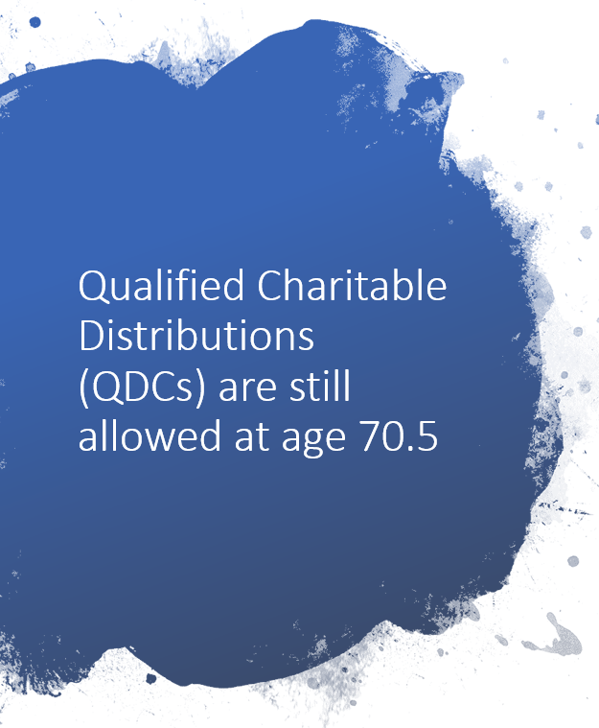
The SECURE ACT - QCDs
What is a QCD? – A Qualified Charitable Distribution, is a distribution from an IRA made directly to an eligible charity, bypassing the owner of the account.
Question: Will pushing back RMD age to 72 also mean that QDCs cannot be made until age 72?
Answer: NO, The SECURE Act makes no changes to the date at which individuals may begin to use IRAs and Inherited IRAs to make QDCs (remains age 70.5).
Example – Steve turns 70.5 in 2020, so he is not forced to take an RMD for 2020. Steve wishes to make a QDC from his IRA during 2020, and is still allowed to do so, up to the $100,000 limit (provided donation is made after he turns 70.5)

Slide 9
The SECURE Act – “Stretch IRAs”
The SECURE Act eliminates the “stretch provision” for many non-spousal beneficiaries of retirement plans.
What is the "stretch provision"? - Under pre-SECURE Act tax rules, designated beneficiaries could stretch required minimum distributions from inherited IRAs (or company sponsored plans) over their own lifetimes.
In many cases this allowed for distributions to be taken over several decades, depending upon the age of the beneficiary
When do you need it?
Why do you need it?
Where do you keep it?
How much risk?
Planning Tip: If you're the beneficiary of an Inherited IRA or retirement plan and the original owner passed away prior to January 1, 2020, you are still able to continue using "stretch provision" and no changes are required

Slide 10
The SECURE Act – “Stretch IRAs”
The SECURE Act replaces the “stretch provision” with a 10–year paydown period
Other than the few Eligible Designated Beneficiary exceptions, the SECURE Act replaces the stretch provision with a 10-year pay down period.
10-year paydown period eliminates annual RMDs, instead requires the entire inherited IRA (or plan) account balance be taken by the end of the 10th year after death
Example: On 1/20/2020, Joe's father passed away, leaving Joe his $1M IRA. Joe is currently 58 years old, still employed and earning $150,000 per year, but plans to retire in 5 years at age 63. Given that Joe's income will decrease substantially when he retires, it may make sense for him to avoid taking any withdrawals during the first 5 years of the distribution window. Instead he can opt to distribute funds during years 6-10, when he expects his income and tax rate to be much lower
Planning Tip: Since the only requirement is to empty inherited account within 10-year paydown period, designated beneficiaries will have some flexibility around the timing of their distributions. Creative planning may allow for tax benefits when choosing which year(s) to make withdrawals

Slide 11
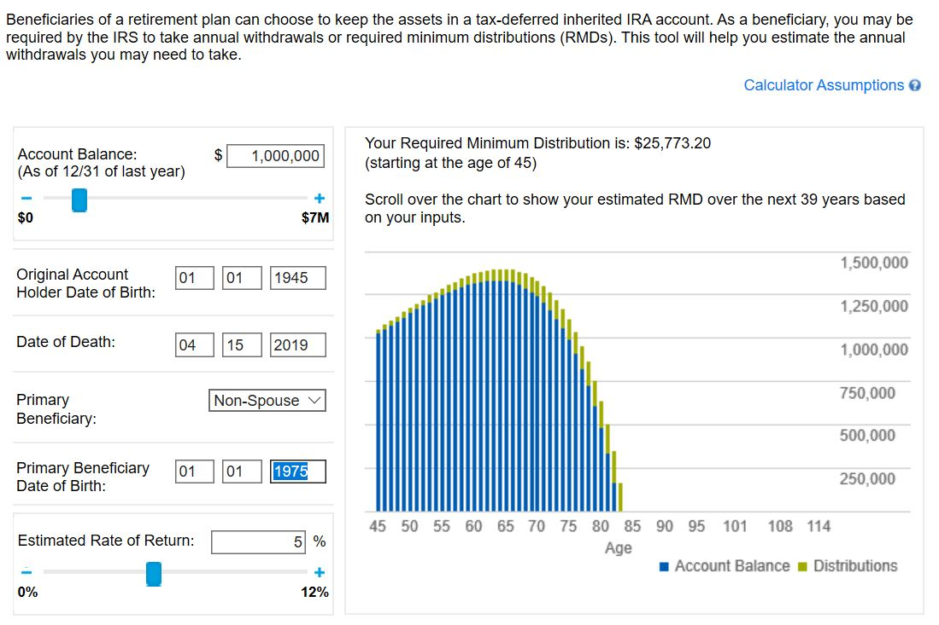
The SECURE Act – “Stretch IRAs”

Slide 12
The SECURE Act – “Stretch IRAs”

Slide 13
The SECURE Act – “Stretch IRAs”

Slide 14
The SECURE Act – “Stretch IRA” EDBs
5 classes of Eligible Designated Beneficiaries (EDB)that can still utilize the "stretch provision"
Surviving spouses
Minor children (not grandchildren) but only until they reach the age of majority in their state of residence
Disabled individuals (under strict IRS definition)
Chronically ill individuals
Individuals not more than 10 years younger than the original account owner (generally siblings)
* If an eligible designated beneficiary no longer meets definition, the 10-year rules applies for them or their beneficiaries.
$30,000
Example: Bob is a 45-year old IRA owner with a 10-year-old daughter. The age of majority in the state where Bob lives is 18.
Bob passes away, leaving his IRA to his daughter. His daughter will need to take regular lifetime RMDs until she reaches age 18. Once she turns 18, the 10-year paydown rule applies - requiring the entire inherited IRA to be depleted over the next decade (by the end of the year she turns age 28)

Slide 15
The SECURE Act – “Stretch IRAs”
The effective date of the 10-year paydown rule for Collective Bargaining Agreements, Thrift Savings Plan, and other government plans is January 1,2022.
For the most part, changes to the "Stretch" rules created by the SECURE Act will impact beneficiaries beginning in 2020. However, Congress did carve out a few exceptions, as follows:
Certain plans, such as 403(b) and 457 plans sponsored by state and local governments, and the Thrift Savings Plan sponsored by the Federal government are not impacted until January 1, 2022
Plans maintained pursuant to a collective bargaining agreement have an effective date of January 1, 2022
Annuities, in which individuals have irrevocably annuitized over their life expectancy (or joint life expectancy) are exempt

Slide 16
The SECURE Act - Beneficiaries
CONSIDER – A tax-smart approach to assigning beneficiaries
Evaluate each account type based upon the tax-treatment upon death of the original owner (stepped up tax cost basis, are withdrawals taxed as ordinary income, are withdrawals tax-free?)
Evaluate differences in beneficiary's tax brackets
Re-title beneficiary designations so lower tax bracket individuals inherit the least tax-favorable assets
Calculate and draft a "compensating adjustment" amount to account for impact of income taxes. Adjustments may need to change over time depending upon all relevant factors (e.g. change in account value, change in beneficiary’s tax situation)

Slide 17
The SECURE Act – Beneficiary Case Study
Case Study – using a tax-smart approach to assigning beneficiaries
SCENARIO:
Assume an individual has 2 children and wants to determine most tax-efficient manner to leave their assets
Individual has estate consisting of a $500,000 IRA and $750,000 in cash, investments and real estate
Child 1 is in a 20% combined federal & state tax bracket, Child 2 is in a 40% combined federal & state tax bracket

Slide 18
The SECURE Act – Beneficiary Case Study
Option A (tax-inefficient): Designate beneficiaries equally on all assets
Using Equal Beneficiary Designation:
Child 1 receives 50% of $500,000 IRA ($250,000). After 20% paid in taxes, Child 1 nets $200,000 from IRA
Child 1 receives 50% of $750,000 from cash, investments and real estate ($375,000) with no taxes due on these assets
Child 1 receives total net inheritance of $575,000 ($200k + $375k)
Child 2 receives 50% of $500,000 IRA ($250,000). After 40% paid in taxes, Child 2 nets $150,000 from IRA
Child 2 receives 50% of $750,000 ($375,000) with no taxes due on these assets
Child 2 receives total net inheritance of $525,000 ($150k + $375K)
**The beneficiaries collectively pay a total of $150,000 in taxes and Child 2 receives less net-inheritance

Slide 19
The SECURE Act – Beneficiary Case Study
Option B (tax-efficient) – title beneficiary designations using a tax smart approach
Tax Smart Designation:
Child 1 receives $500,000 IRA and a $100,000 cash as a “compensating adjustment” (to cover 20% taxes on IRA)
Child 1 receives $75,000 of cash, investments and real estate (income-tax free).
On an after-tax basis, child 1 receives $575,000.
Child 2 receives $575,000 from cash, investment accounts and real estate (income-tax-free)
On an after-tax basis, child 2 receives $575,000
**Each child receives an identical amount on an after-tax basis. Family saves $50,000 in taxes ($100k using Option B vs. $150k using option A)

Slide 20
The SECURE Act – Roth Conversions
What is a Roth conversion?
Roth conversion refers to taking all or part of a pre-tax retirement plan and moving it into a Roth retirement plan.
Roth conversions are taxable events, with taxes are due in the year that the conversion was executed and are subject to that year's tax rates.
Money in Roth accounts grows tax-deferred and withdrawals are entirely tax-free.
Inherited Roth IRA and Roth 401(k)s are still subject to the new 10-year distribution requirement. However, since Roth accounts are tax-free, they avoid the punitive high tax rates beneficiaries may encounter with inherited traditional (pre-tax) retirement accounts
High taxes resulting from the new 10-year distribution requirement can cut inherited tax-deferred accounts in half. This risk is heightened if distributions fall while the beneficiary is mid-career, when earnings and taxes are already high.

Slide 21
The SECURE Act – Roth Conversions
Consider performing Roth conversions from traditional, pre-tax retirement accounts during the timeframe between the end of regular employment and the start of pensions, Social Security, and age 72 RMDs.
Delaying Social Security retirement benefits and the pushing back of RMDs to age 72 increase the potential Roth conversion window
Evaluate current vs. future tax brackets to determine “optimum” Roth conversion amount and timing strategy
Consider accumulating assets outside of retirement plans – to provide a source of income that is not subject to ordinary income taxes. Some examples include non-retirement investment accounts, bank savings accounts or equity from the sale of a property.

Slide 22
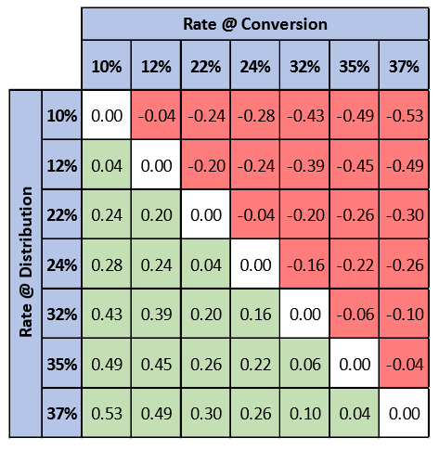
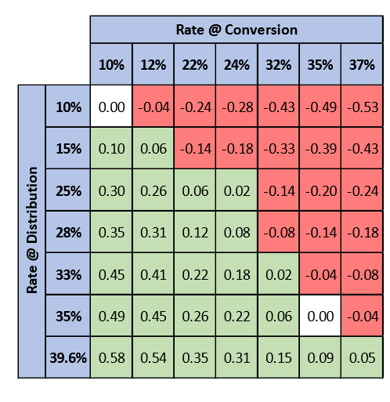
The SECURE Act – Roth Conversions
10-Year analysis period
7% rate of return
Tax paid from retirement account
RMDs do not start within period
10-Year analysis period
7% rate of return
Tax paid from retirement account
RMDs do not start within period
Sunset tax rates (1/1/2026)
**A positive factor indicates an effective conversion, whereas a negative factor indicates an ineffective conversion
Source: Keebler & Associates, LLP

Slide 23
The SECURE Act – Other Key Tax Provisions
Extended tax provisions through 12/31/2020
Sec 108(a)(1)(E), which excludes from gross income the discharge of qualified principal residence indebtedness income. Provision expired 12/31/17 and has been extended retroactively
Sec 163(h)(3) treatment of mortgage insurance premiums as qualified residence interest. Provision expired 12/31/17 and has been extended retroactively.
7.5% (instead of 10%) AGI floor for medical expense deductions in Sec 213(f).
Sec 222, which provides an above-the-line deduction for qualified tuition and related expenses.
Sec 25C(g)(2) tax credits for nonbusiness energy property
3-year recovery period for racehorses (if age is under 2)
Notable Exclusions
15-year life for Qualified Improvement Property
Other tax changes
Kiddie tax in Sec 1(j)(4) is repealed. Originally introduced in the TCJA of 2018 by applying trust tax rates.

Slide 24
The Secure Act – Trust Planning

Slide 25
The Secure Act – Paying IRAs to Trusts
Benefits of Utilizing a Trust
Spendthrift protection
Creditor protection
Divorce Protection
Special needs
Investment management
Estate Planning
Income Tax Planning is even more Important after Secure

Slide 26
The Secure Act – Paying IRAs to Trusts
Conduit Trust
A trust in which all distributions from the IRA are immediately distributed to the trust beneficiary(ies).
Some asset protection
IRA
Annual RMD
Conduit
Trust
Annual RMD
Beneficiary
Required
Ten-Year Rule Dilemma

Slide 27
The Secure Act – The Conduit Trust Dilemma
Years After Death |  | Current RMD Method | 10-Year Rule Options
 |  |  | Equal Schedule | Full Deferral
0 | 30 | $18,762 | $142,378 | $0
1 | 31 | $20,100 | $142,378 | $0
2 | 32 | $21,535 | $142,378 | $0
3 | 33 | $23,072 | $142,378 | $0
4 | 34 | $24,720 | $142,378 | $0
5 | 35 | $26,486 | $142,378 | $0
6 | 36 | $28,379 | $142,378 | $0
7 | 37 | $30,409 | $142,378 | $0
8 | 38 | $32,584 | $142,378 | $0
9 | 39 | $34,917 | $142,378 | $0
10 | 40 | $37,417 | $142,378 | $1,967,151
$298,381 |  | $298,381 | $1,423,780

Slide 28
The Secure Act – Paying IRAs to Trusts
Accumulation Trust
A trust in which distributions from the IRA are allowed to accumulate within the trust.
Stronger asset protection than a conduit trust.
Annual Discretionary
IRA
Annual RMD
Accumulation
Trust
Beneficiary
Required

Slide 29
The Secure Act – The Accumulation Trust Dilemma
2020 37% Rate
Trust | Single Filer | MFJ Filer
$12,950 | $518,400 | $622,050
Trusts reach the top income tax bracket at only $12,950 of income

Slide 30
The Secure Act – The Big Decision
Most non-spouse beneficiaries must withdraw the entire balance of the retirement account within ten years, and
The Income tax due will be accelerated.
Do we save on taxes or protect the retirement account from the beneficiary’s creditors, lawsuits, and possible divorce?

Slide 31
The Secure Act – The Need to Review and Amend Trust Documents
Your estate plan needs to be reviewed to determine what is going to happen to your retirement account.
If a conduit trust provision was used, you need to consider whether it’s necessary to amend or update your trust to prevent the beneficiary from getting the entire balance within ten years of your death.

Slide 32
The Secure Act – Check Your Beneficiary Designations
This is a great time to review your account information
Are your beneficiary designations correct:
Do they follow your estate plan?
Is your trust properly named (if appropriate)?
Has there been a change in your life or circumstances? (Have you gotten married or divorced?)

Slide 33
Thank you
4650 East Cotton Center Blvd
STE 130
Phoenix Arizona, 85040
480-776-5960
www.ironwoodwm.com
4500 South Lakeshore Drive STE 560
Tempe Arizona, 85282
480-456-6267
www.sotolawfirm.com
Evaluation Forms - We ask each attendee to please take a moment to complete this form.
Panel Discussion - Open for all questions.

